Slide 1

The Gravity Project: Consensus-driven Standards on Social Determinants of Health
Overview for Health TechNet
February 19, 2021
Evelyn Gallego, MBA, MPH, CPHIMS
Gravity Program Manager

Slide 2
Agenda
Gravity Project Team
Background (WHY)
Project Scope (WHAT)
Accomplishments & Success Factors
How to Engage

Slide 3
Gravity Project Team

Slide 4



Gravity Project Management Office (PMO)
Caroline Fichtenberg, Managing Director, UCSF/ SIREN
Evelyn Gallego, Program Manager, EMI Advisors
Carrie Lousberg, Project Manager, EMI Advisors
Mark Savage, SDOH Policy Lead, USCF/SIREN
Sarah DeSilvey, Clinical Informatics Director, University of Vermont
Bob Dieterle, Technical Director, EnableCare

Slide 5

Workstream Teams
Terminology- Director, Sarah DeSilvey
Linda Hyde, Terminology Expert, EMI Advisors
Subject Matter Experts
Food Insecurity:
  Donna G. Pertel, Academy of Nutrition and Dietetics
Housing Insecurity/ Homelessness:
  Megan Sandel, Allison Bovell-Ammon, Rich Sheward, Children’s Health Watch
Transportation:
  Alexandra King, Community Transportation Assoc. of America
  Jennifer Sisto Gall, Lyft
  Ipek Sener, Texas A&M Transportation Institute
  Michael Adelberg, Medical Transportation Access Coalition
Financial Insecurity:
  Adam Schickedanz, UCLA Health
  Jeffry Colvin, U Missouri/ Kansas
Technical- Director, Bob Dieterle
Monique Van Berkum, FHIR Modeling Lead, AMA
Corey Smith, FHIR IG Project Coordination, AMA
Jim Shalaby, AMA Technical Consultant
Becki Gradl, Food Insecurity Tech Lead, Academy of Nutrition and Dietetics
And many more!

Slide 6






Gravity Governance Structure (Federal Participation)
Executive Committee
15 members, at least 2 from each of:
1. Patients/Consumers 4. HIT Vendors (3)
2. Providers (3) 5. Community Based Orgs
3. Payers (3) 6. Federal Government
Strategic Advisory Committee
All Financial Sponsors & Invited In-Kind Contributors. At least 2 of:
1. Patients/Consumers 4. HIT Vendors
2. Providers 5. Community Based Orgs
3. Payers 6. Federal Government
Program Management Office
Gravity Operational Guidelines: https://confluence.hl7.org/pages/viewpage.action?pageId=91996161
Workstreams
Technical Advisory Committee
At least 2 representatives from:
1. Patients/Consumers 4. HIT Vendors
2. Providers 5. Community Based Orgs
3. Payers 6. Federal Government
Gravity Public Collaborative
Elastic: 1,500+ members
HL7 SDOH FHIR IG Workgroup
Elastic: 50+ members

Slide 7



















Gravity Project Sponsorship (Financial & In-Kind)
Yale School of Nursing
siren
https://confluence.hl7.org/display/GRAV/Gravity+Project+Sponsors

Slide 8
Overview

Slide 9
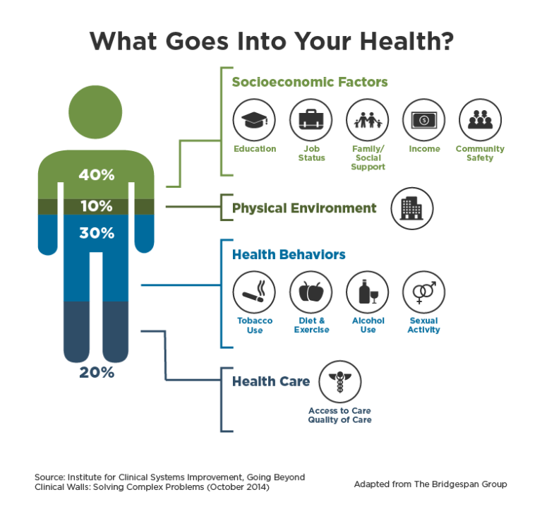
Why Social Determinants of Health (SDOH) are Important
There is broad consensus that SDOH information improves whole person care and lowers cost. Unmet social needs negatively impact health outcomes.
Food insecurity correlates to higher levels of diabetes, hypertension, and heart failure.
Housing instability factors into lower treatment adherence.
Transportation barriers result in missed appointments, delayed care, and lower medication compliance

Slide 10
Uses for Social Risk Data in Clinical Settings
Medical Care
Social Risk Interventions
Population Health Management
Risk Adjustment
Research
Community Health Improvement

Slide 11
Challenges in SDOH Data Capture and Exchange
Consent Management
Standardization of SDOH Data Collection and Storage
Data Sharing Between Ecosystem Parties
Access & Comfort with Digital Solutions
Concerns about Information Collection and Sharing
Social Care Sector Capacity and Capability
Unnecessary Medicalization of SDOH
https://www.nasdoh.org/wp-content/uploads/2020/08/NASDOH-Data-Interoperability_FINAL.pdf

Slide 12




SIREN Social Risk Codes Review
Arons A, DeSilvey S, Fichtenberg C, Gottlieb L. Documenting social determinants of health-related clinical activities using standardized medical vocabularies. JAMIA Open. 2018;2(1):81-88. (http://sirenetwork.ucsf.edu/tools-resources/mmi/compendium-medical-terminology-codes-social-risk-factors)

Slide 13
SIREN Social Risk Codes Review
Arons A, DeSilvey S, Fichtenberg C, Gottlieb L. Documenting social determinants of health-related clinical activities using standardized medical vocabularies. JAMIA Open. 2018;2(1):81-88. (http://sirenetwork.ucsf.edu/tools-resources/mmi/compendium-medical-terminology-codes-social-risk-factors)

Slide 14
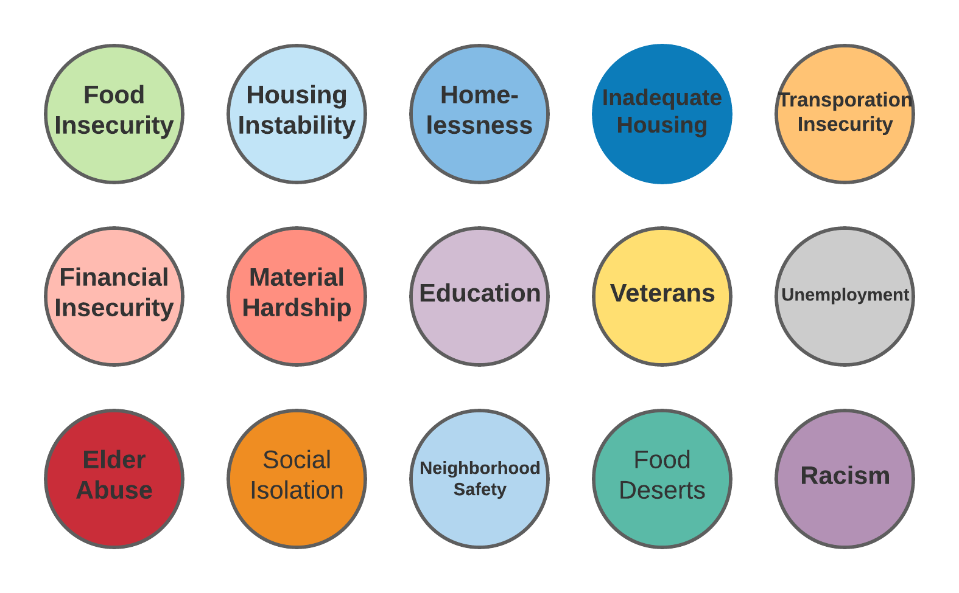
Enter the Gravity Project…
Goal
Develop consensus-driven data standards to support use and exchange of social determinants of health (SDOH) data within the health care sectors and between the health care sector and other sectors.

Slide 15

Project Scope
In May 2019, the Gravity Project was launched as a multi-stakeholder public collaborative with the goal to develop, test, and validate standardized SDOH data for use in patient care, care coordination between health and human services sectors, population health management, public health, value-based payment, and clinical research.
Gravity Project Scope: Develop data standards to represent patient level SDOH data documented across four clinical activities: screening, assessment/diagnosis, goal setting, and treatment/interventions.
https://confluence.hl7.org/display/GRAV/The+Gravity+Project

Slide 16
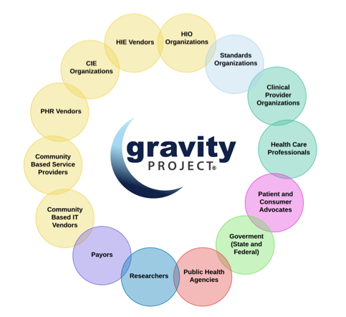
SDOH Interoperability Glide Path
HL7 FHIR Accelerator: In August 2019, Gravity officially joined the HL7 FHIR Accelerator Program and balloted the first HL7 SDOH FHIR IG in Dec. 2020.
Public Collaboration: Gravity has convened over 1,500+ participants from across the health and human services ecosystem from clinical provider groups, community-based organizations, standards development organizations, federal and state government, payers, and technology vendors.
Public Workgroup Meets bi-weekly Thursdays 4 to 5:30 PM ET https://confluence.hl7.org/pages/viewpage.action?pageId=91996855#TheGravityProject-UpcomingGravityProjectMeeting

Slide 17
Gravity Overview: Two Streams
New Code Submissions
FHIR IG Testing
Coding Gap Analysis & Recommendations
FHIR IG Development
3
3
2
2
Terminology(SDOH Domains)
CODED VALUE SETS
Technical (HL7 FHIR)
Data Set Identification
1
1
Community & FHIR Coordination
4
4
Publication in NLM VSAC & ONC ISA
FHIR IG Ballot & Publication
Notes:
How does the terminology and technical work interact?
Coding Recommendations inform temp codes in FHIR IG build
Published FHIR IG will point to publish value sets in VSAC
Why this work matters
Essential to integrate SDOH data in health care
Essential for health care to identify the right social need interventions

Slide 18
Terminology Workstream

Slide 19
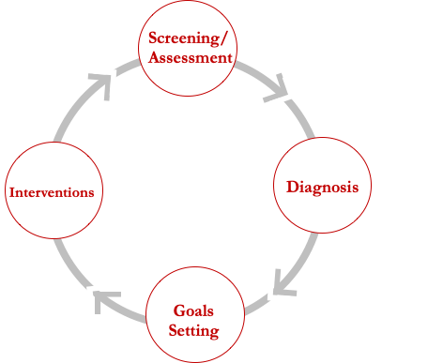

Terminology Workstream
Data Element and Ensuring Gap Analysis
All data is sorted across four activities into a master set.
For data within each domain, we ask:
  What concepts need to be documented across the four activities?
  What codes reflecting these concepts are currently available?
  What codes are missing?

Slide 20
Gravity Roadmap
2020 | 2021
JAN | FEB | MAR | APR | MAY | JUN | JUL | AUG | SEP | OCT | NOV | DEC
JAN | FEB | MAR | APR | MAY | JUN | JUL | AUG | SEP | OCT | NOV | DEC
FOOD INSECURITY
New Use Case Development
FOOD DESERT
HOUSING INSTABILITY & HOMELESSNESS
BREAK
INADEQUATE HOUSING
NEIGHBORHOOD SAFETY
TRANSPORTATION INSECURITY
TERMINOLOGY
FINANCIAL INSECURITY
MATERIAL HARDSHIP
DEMOGRAPHICS
INTIMATE PARTNER VIOLENCE
SOCIAL ISOLATION
STRESS
Key
LOINC Code Submissions (MAR/ OCT)
SNOMED Code Submissions (MAY/DEC)
ICD-10 Code Submissions (JUN/DEC)
Gravity FHIR IG Development
IG Ballot
Final updates/ IG Publication
IG Ballot Reconciliation
TECHNICAL
Reference Implementation Development
Reference Implementation Update
HL7 FHIR Connectathons
SDOH FHIR IG PILOTS
PILOTS
WE ARE HERE
Notes:
LOINC submission April 27 for June release, Oct 1 for Dec release
SNOMED submission June 15 for Sept release
ICD-10 submission June 12 for Oct release

Slide 21
Terminology Stream Status
Legend
Domain | Terminology Identification Plan Gather Review Finalize |  |  |  | Code Submission Submit Finalize |  | Value Set Publication
Food Insecurity
Housing Instability/ Homelessness
Inadequate Housing
Transportation Insecurity
Financial Strain
Demographics
Complete (100%)
Partially Complete (+50%)
Partially Complete (+75%)
Not Complete (0%)

Slide 22
Food Insecurity Terminology Build
Q. Within the past 12months we worried whether our food would run out before we got money to buy more. LOINC 88122-7
A. Often true, Sometimes true, Never true, don’t know/refused. LOINC LL4730-9
PROCEDURE: Education about Child and Adult Food Program SNOMED 409073007*
PROCEDURE: Provision of food voucher SNOMED 119270007*
Food Insecurity Observation: Mild food insecurity, moderate food insecurity, severe food insecurity
SNOMED 733423003
Food Insecurity Diagnosis: ICD-10 Z59.42
Mild food insecurity Z59.421
Moderate food insecurity Z59.422
Severe food insecurity Z59.423
Food Insecurity, unspecified Z59.429
REFERRAL: Referral to Dietician Nutritionist SNOMED 103699006
Intervention for Food Insecurity LOINC TBD
Decrease in severity of food insecurity LOINC TBD
Decline in prevalence of food insecurity LOINC TBD
* Proposed. Not final.

Slide 23
Interventions Framework
Gravity Term | Definitions
Assistance/ Assisting | To give support or aid to; help
Coordination | Process of organizing activities and sharing information to improve effectiveness
Counseling | Psychosocial procedure that involves listening, reflecting, etc. to facilitate recognition of course of action / solution.
Education | Procedure that is synonymous with those activities such as teaching, demonstration, instruction, explanation, and advice that aim to increase knowledge and skills.
Evaluation of eligibility (for <x>) Subtype of Evaluation | Process of determining eligibility by evaluating evidence
Evaluation/ Assessment | Determination of a value, conclusion, or inference by evaluating evidence.
Provision | To supply/make available for use
Referral | The act of clinicians/providers sending or directing a patient to professionals and/or programs for services (e.g., evaluation, treatment, aid, information, etc.)

Slide 24
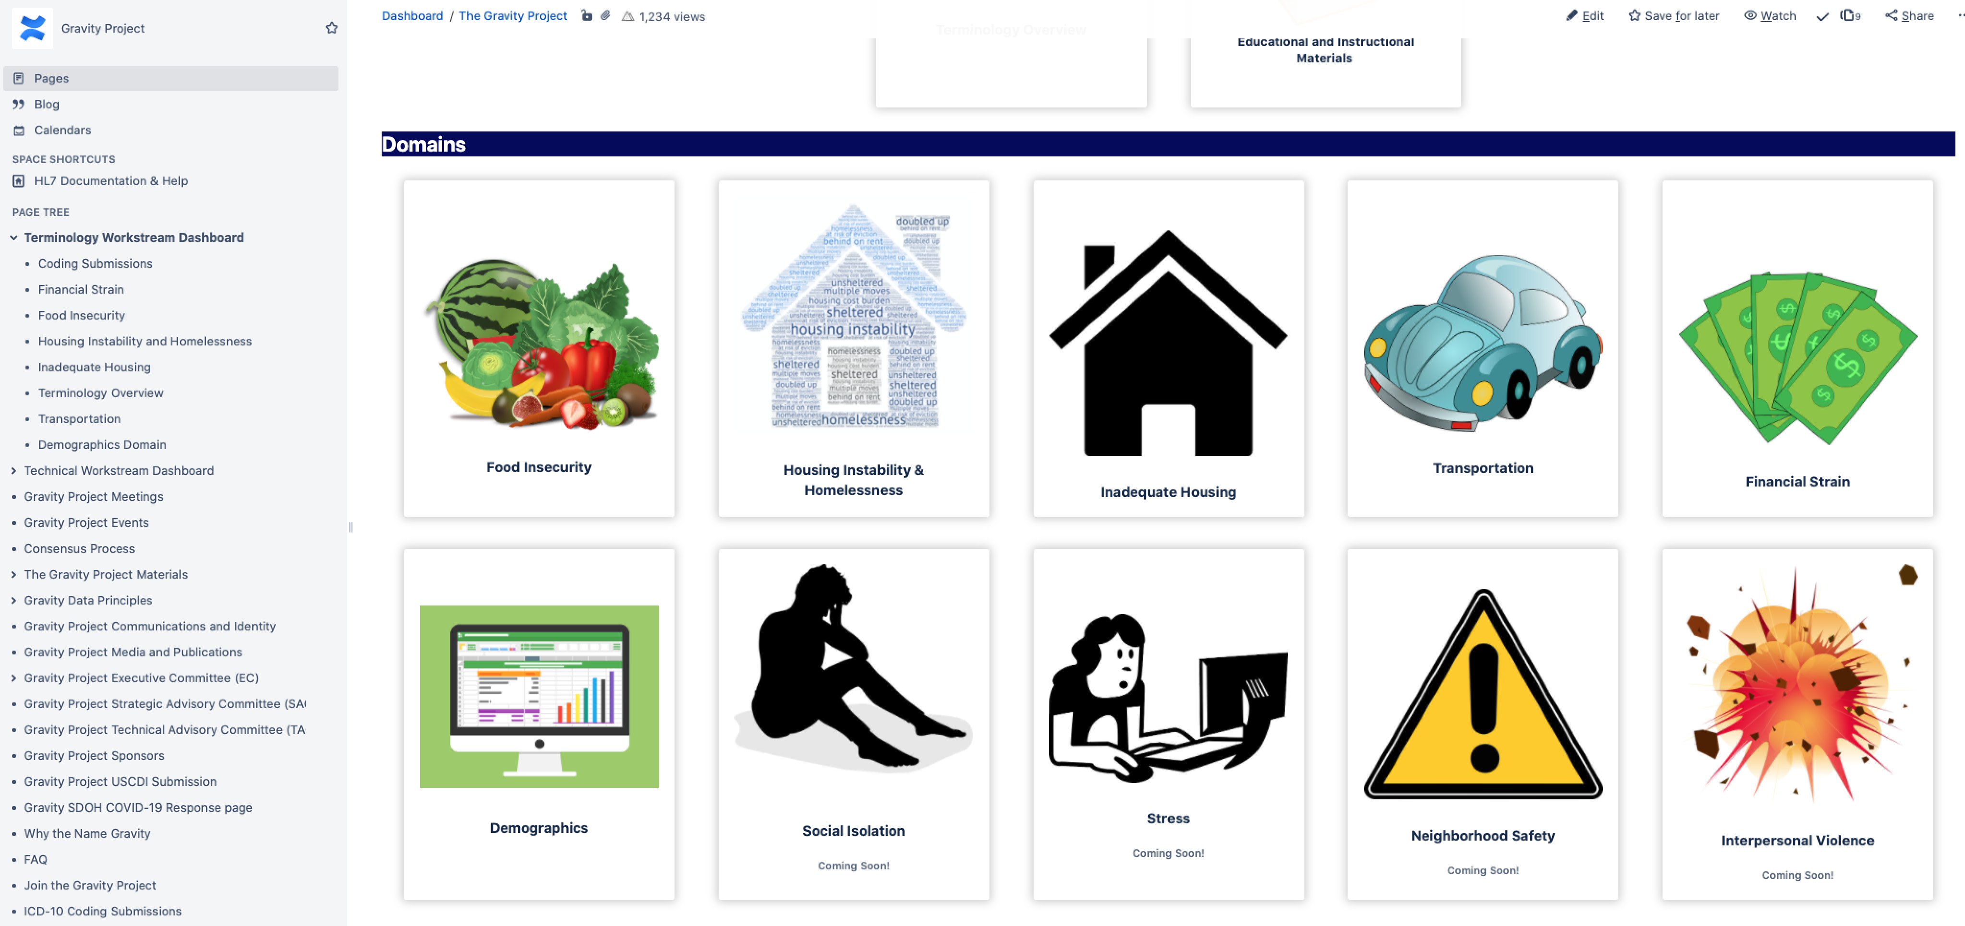
Where to find Published Gravity Data Sets?
https://confluence.hl7.org/display/GRAV/Terminology+Workstream+Dashboard

Slide 25
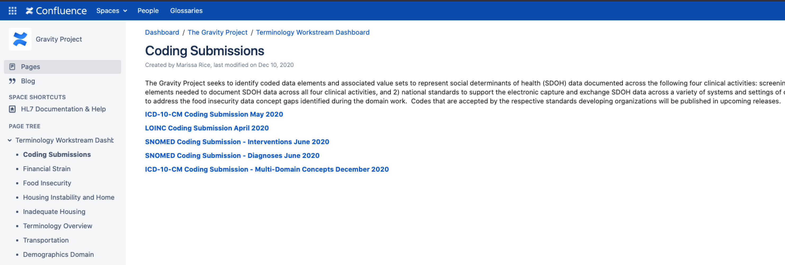
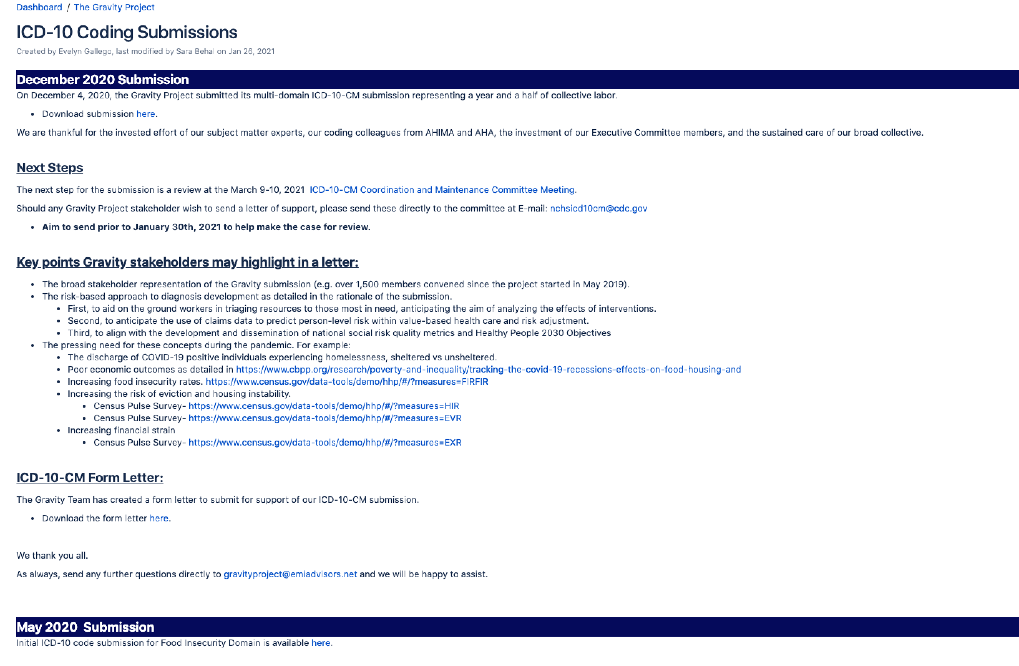
Where to find Gravity Data Sets New Code Submissions?
https://confluence.hl7.org/display/GRAV/Coding+Submissions
https://confluence.hl7.org/pages/viewpage.action?pageId=97470545#ICD10CodingSubmissions-December2020Submission

Slide 26
Technical Workstream

Slide 27
Technical Workstream: Accelerating Adoption Using Nationally Recognized Standards
The universal language attributed to the concepts, so they are understood across users and systems (semantics)
The structure (syntax) for how the data is displayed and shared electronically from system to system.
Fast Health Interoperability Resource

Slide 28
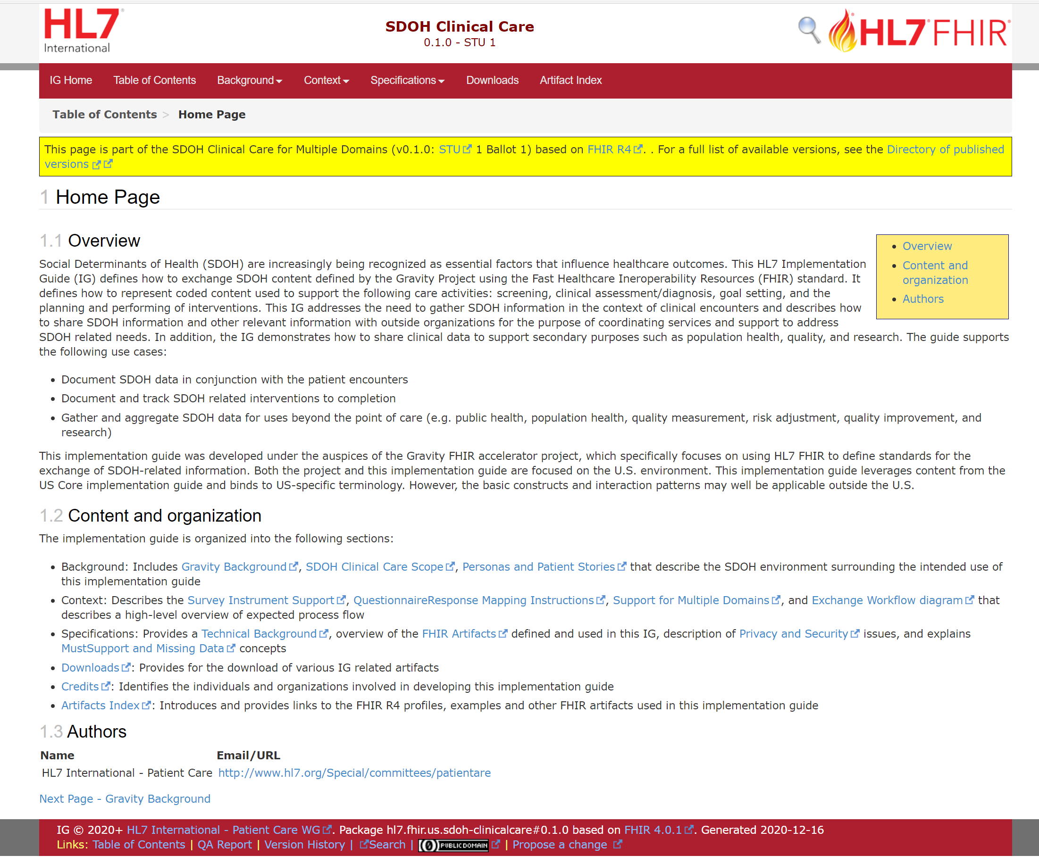
Technical Stream – SDOH Clinical Care FHIR Implementation Guide
This is a framework Implementation Guide (IG) and supports multiple domains
IG support the following clinical activities
  Assessments
  Health Concerns / Problems
  Goals
  Referrals
  Consent
  Aggregation for exchange/reporting
Completed January 2021 ballot as a Standard for Trial Use Level 1 (STU1)
http://hl7.org/fhir/us/sdoh-clinicalcare/2021Jan/

Slide 29
Gravity FHIR SDOH Clinical Care IG Scope
Document SDOH data in conjunction with the patient encounter
Set SDOH related goals.
Establish and related interventions to completion.
Document and measure outcomes.
Gather and aggregate SDOH data or uses beyond the point of care (e.g. population health management, quality reporting, and risk adjustment/ risk stratification).
Manage patient consent
5
Outcomes (Procedures/Quality Measures)
1
4
6
Document/Measure/Survey
2
Interventions (e.g., by CBOs)
3
3
Execute
Interventions (SNOMED-CT, CPT/HCPCS)
3
4
Aggregation and Reporting
Consent
Plan/Assign
5
Goals (LOINC)
2
Set
Health Concerns / Problems (ICD-10-CM and SNOMED-CT)
1
6
Coding
Assessment/Survey (LOINC coded)
1
http://build.fhir.org/ig/HL7/fhir-sdoh-clinicalcare/

Slide 30
FHIR IG Connectathon Jan. 13 to 15th 2021
Gravity Connectathon Track Page
https://confluence.hl7.org/display/FHIR/2021-01+Gravity+SDOH+Clinical+Care+Track
Connectathon Goals: Test the SDOH Clinical Care FHIR IG. The SDOH FHIR IG provides a framework for multiple SDOH domains. The track tested three use cases:
  Exchange and update interventions between a provider and CBRO or CBO
  Continue testing support for risk surveys
  Exchange health concerns / problems and interventions for a cohort of individuals
Track Leads: Bob Dieterle, Corey Smith (AMA), Monique Van Berkum (AMA)
Total Participants: on average 25-35 per day

Slide 31

Notable Achievements
Successfully connected and exchanged SDOH data with the reference implementation using the IG in the context of:
  closed loop referral use case
  responsible payer query of the provider EHR
Demonstrated a proof of concept of the dynamic value sets that will be maintained external to the IG.
Demonstrated the approach of a limited set of "multi-domain" SDOH profiles supported by externally maintained, dynamic value sets
Demonstrated FHIR Mapping/StructureMap approach to auto-generating screening response observations as well as calculated health concerns (conditions) (joint presentation with SDC)
The LogicaSandbox, used to set up 2 FHIR servers, enabled testing and was extremely valuable.

Slide 32
What's Next?
Continue to engage with NLM, Regenstrief and other stakeholders to advance tooling that supports the multi-domain Gravity IG, externally maintained dynamic value sets, and questionnaires.
Continue to engage the community to establish the clinical content required for multiple SDOH domains.
Continue to advance the development of the reference implementation development.
Continue FHIR IG ballot reconciliation (over 200 comments received).
Begin Gravity Pilots Design for target summer 2021
Please join us at the Gravity SDOH FHIR IG Workgroup Calls every Wednesday from 3 to 4 pm ET
  https://confluence.hl7.org/display/GRAV/FHIR+IG+Work+Group+Meetings

Slide 33
Accomplishments & Success Factors

Slide 34
Accomplishments & Success Factors
January 2020: Completed food insecurity coding gap analysis and recommendations.
March 2020: Launched housing instability domain.
May - June 2020: Submitted new code applications for food insecurity to the coding stewards. Tested draft HL7 FHIR SDOH Implementation Guide (IG) at two FHIR Connectathons; achieved 1st place status in competition.
September 2020: Tested HL7 FHIR SDOH IG at FHIR Connectathon; launched Transportation and Inadequate Housing Domains; completed Housing Instability & Homelessness data set.
October 2020: Launched financial strain and demographics domains in parallel; submitted SDOH Data Class Application to ONC USCDI
December 2020: Presented new ICD-10 codes for ICD-10 2021 review cycle; submitted FHIR SDOH IG for the January 2021 HL7 ballot cycle; began build of Reference Implementation.
January 2021: Gravity standards included in CMS State Health Official (SHO) Medicaid guidance and in ACL Social Referrals Challenge Grant submissions; publish final data sets for Transportation, Financial Strain, Demographics status; began FHIR IG ballot reconciliation; tested FHIR IG at the HL7 FHIR Connectathon.
POLICY: (e.g. ONC USCDI, CMS Promoting Interoperability, State Medicaid Director Letters)
PAYMENT MODELS: (e.g. CMMI SDOH Model)
PROGRAMS: (e.g. Medicare Advantage, Medicaid Managed Care, Hospital QRRP, MIPS).
GRANTS: (e.g. ACL Challenge Grant, ONC Health IT LEAP, RWJF SDOH Integration in Clinical Care).
PRACTICE: (e.g. repeatable process for adoption, implementation, and use of SDOH data at practice level.
INNOVATION: New tools for capture, aggregation, analytics, and use.

Slide 35
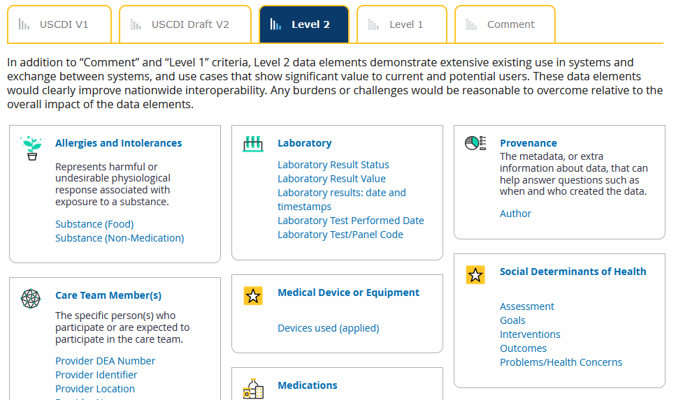
Policy Integration: Gravity USCDI Submission
The Gravity Project formally made a submission to the ONC U.S. Core Data for Interoperability (USCDI) version 2 in October 2020.
Submission available here: https://confluence.hl7.org/display/GRAV/Gravity+Project+USCDI+Submission
https://www.healthit.gov/isa/united-states-core-data-interoperability-uscdi

Slide 36
Policy Integration: CMS NPRM Request for Information on Social Risk Data Standards
On December 18, CMS published a notice of proposed rulemaking (NPRM) on prior authorization and patients’ electronic access to health information. The NPRM included a “Request for Information: Accelerating the Adoption of Standards Related to Social Risk Data.”
  The request asked four questions about current mechanisms, challenges, barriers, and strategies for standardizing and exchanging social risk data.
  The request is very relevant to the Gravity Project’s work.
The Gravity Project’s PMO quickly prepared answers over the holiday and submitted a response to CMS on January 4, 2021.
  Read the letter here: https://confluence.hl7.org/display/GRAV/CMS+RFI+-+Accelerating+Adoption+of+Standards+Related+to+Social+Risk+Data

Slide 37
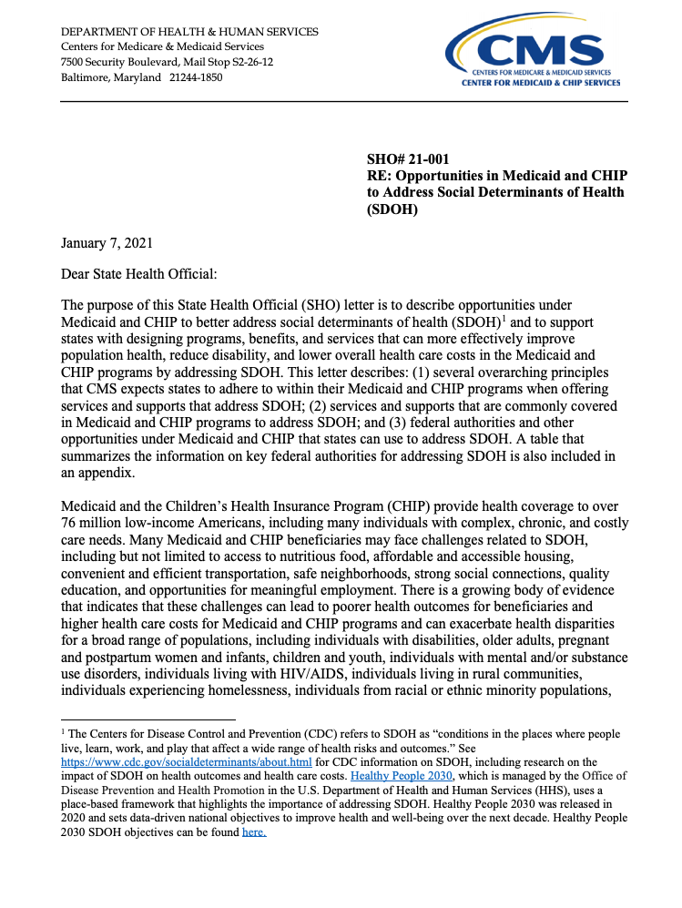
Policy Integration: CMS State Health Official Letter
On January 7th, CMS released guidance for states on opportunities under Medicaid and CHIP to address SDOH.
The guidance acknowledges that states can leverage Medicaid resources to support data integration and data sharing to assist state health systems to identify individuals with SDOH needs and link them to appropriate medical and social supports.
States are required to design technical infrastructure for Mechanized Claims Processing, Information Retrieval Systems, and care coordination hubs that are interoperable with human services programs, HIEs, and public health agencies, as applicable.
States must ensure alignment of the claims processing and IRS systems with CEHRT.
States are encouraged to review ISA SDOH standards and review and participate in the Gravity Project.
https://www.medicaid.gov/federal-policy-guidance/downloads/sho21001.pdf

Slide 38
Grants Integration: ACL Social Care Referrals
ACL announced a competition for state and community leaders in the aging and disability network, health care systems, health plans, and health IT vendors to cultivate care coordination by developing and/or interoperable and scalable technology platforms
Technical approach and/or specifications, which may include both technical details, such as architecture, workflows, schemas, data exchange standards, and API endpoints, for the following:
  Technical approach and/or specifications for establishing open community resource directories using the Human Services Data Specifications (HSDS).
  Technical approach and/or specifications for the team’s approach for incorporating and standardizing SDOH data content using the Gravity Project’s identified terminology and technical standards.
Phase 1 : Concept & Design Submission (July to Dec. 2020)
Phase 2: Proof of Concept Demonstration (Jan. to June 2021)
Phase 3: Implementation & Testing (July to Dec. 2021)
Total Prize award: $500,000
https://www.challenge.gov/challenge/innovative-technology-solutions-for-social-care-referrals/

Slide 39
Practice and Innovation Integration
CyncHealth (formally NEHII) Health Information Exchange Integration here.
American Academy of Pediatrics (AAP) and the Food Research & Action Center (FRAC) "Screen and Intervene: A Toolkit for Pediatricians to Address Food Insecurity" here.
National Quality Forum Guidelines for High EHR Data Quality, Quality Measures here.
Onyx and AMA Innovations Partner to Rethink Ways FHIR-based Technology Can Improve Links Between Health Care and Community-Based Organizations here.
Lyft Healthcare Exec Shares 2021 Predictions, Innovative Strategies here.

Slide 40
How to Engage!

Slide 41
Join our Project!
Join the Gravity Project: https://confluence.hl7.org/display/GRAV/Join+the+Gravity+Project
  Public Collaborative Workgroup meets bi-weekly on Thursdays’ 4:00 to 5:30 pm ET
  SDOH FHIR IG Workgroup meets weekly on Weds. 3:00 to 4:00 pm ET
Help us find new sponsors and partners
Give us feedback on the Data Principles: https://confluence.hl7.org/display/GRAV/Gravity+Data+Principles
Submit SDOH domain data elements (especially for Interventions): https://confluence.hl7.org/display/GRAV/Data+Element+Submission
Help us with Gravity Education & Outreach
  Use Social Media handles to share or tag us to relevant information
    @the gravityproj
    https://www.linkedin.com/company/gravity-project
  Partner with us on development of blogs, manuscripts, dissemination materials

Slide 42
Questions?
Evelyn Gallego evelyn.gallego@emiadvisors.net
Twitter: @egallego
LinkedIn: linkedin.com/in/egallego/
Additional questions? Contact: gravityproject@emiadvisors.net
  @thegravityproj
  https://www.linkedin.com/company/gravity-project

